Slide 1
WaveNet: A generative model for raw audio
Presented by: Shakti Singh
Original paper here

Slide 2
What is WaveNet?
A Generative model that generates raw audio waveforms.
Fully probabilistic and auto regressive model based on PixelCNN architecture (state-of-art in image generation)
Use of Causal and dilated convolutions is done to address long-range temporal dependencies in audio generation.
Can Generate raw speech signals with high naturalness factor (in a text-to-speech setting).
When conditioned on the speaker’s identity, it can generate different voices too.
Also, it can be trained to generate other raw audio waveforms like music.

Slide 3
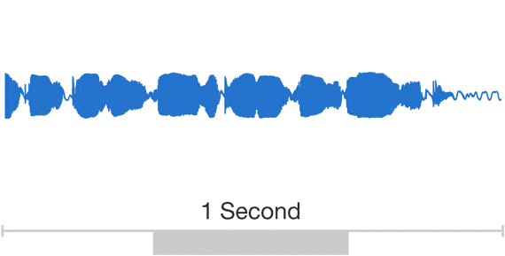
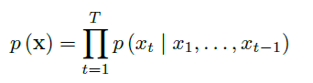
How it works ?
It operates directly on raw audio waveform.
Joint probability of waveform x = {x₁, x₂, . . . x_{T}} can be
Factorized as a product of conditional probabilities :
Each audio sample x_{t} is conditioned over samples at all the previous timesteps.
Source : here

Slide 4
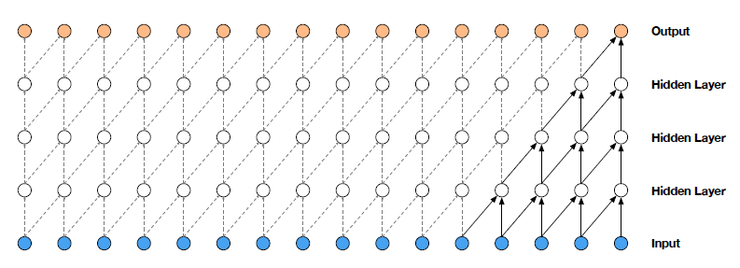
The main ingredient : Causal convolution
The CPD is modelled by using a stack of convolution layers (similar to PixelCNN).
Causal convolution is used here to help maintain the order of modelled data.
In case of images, it can be achieved through a mask tensor. But in case of 1D data as in audio, can be achieved by shifting the output of normal conv.
While training, predictions for all time steps is done in parallel. But while generating, it becomes a sequential model.
Source here
More on Causal convolution : PixelCNN

Slide 5

The dilemma (and a way out)
In case of causal convs. , temporal dependencies are introduced by large receptive field. But we will need large filters and numerous layers to do so.
Dilated convolution is done to increase the receptive field.
A filter is applied to larger area than its length (by skipping the input values by certain step)
Operation on a coarse level than normal convolution.
Very large receptive fields can be achieved by stacking layers of different dilation factors.
In WaveNet, layered blocks of dilation increasing by the order of 2^{n} are stacked together. One such block have a receptive field of 1024 samples.

Slide 6
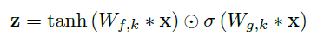

Gated activation Units
Similar to PixelCNN, use of gated activation unit is done.
Where,
* => convolution operation
=> element-wise multiplication operation
W => learnable convolution filter
k => layer index
f => filter
g => gate
Why this specific activation ?
Well, it just seems to work better than others (ReLU) for modelling audio signals.

Slide 7
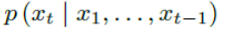
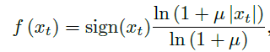
Softmax for modelling
Use of Softmax distribution is done to model the conditional distribution
Works well on modelling categorical distributions because of its flexibility and no assumptions about their shape.
Since raw audio is stored in 16-bit int values (one per timestamp), softmax needs to predict 65,536 probabilities to model all possible values.
Use of µ-law companding transformation is done to quantize the data to 256 possible values.

Slide 8
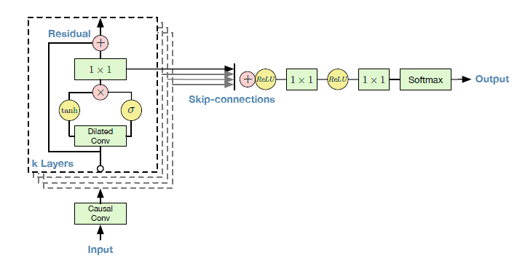
A look at WaveNet architecture

Slide 9
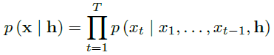
Conditioning in WaveNet
We can condition WaveNet output on an additional input h.
Global conditioning : single representation of h influences the output distribution across all timestamps. The activation function changes to
Local Conditioning : a different time-series h_{t} is used in activation unit after its conversion to a time-series of same sampling rate as that of the input x. y=f(h_{t})
Notes:
We can condition the output distribution of wanenet on an additional input h
Conditioning on an additional input enables the wavenet to learn and generate audio having some specific characteristics (based on what input it is)
Eg: in Text-to-speech setting, the network is conditioned on additional information about the text (like linguistic features)
And conditioning on the identity of the speaker, wavenet can learn and generate the speech in different voices.
It can be done in two ways:
Global conditioning - a single representation of h will influences the output distribution across all time stamps (for eg. speaker embedding in TTS). the activation function turns out to be .. where V is a set of learnable weights and superscript T is for broadcast over time dimension.
Local conditioning - here we have a different time series ht, possibly of lower sampling rate that of input. First ht is converted to same resolution as that of our input using a helper function and then used in activation units.
Thing to notice is that the term containing V have now become a 1x1 convolution.

Slide 10
Experiments and Results
Tested on three tasks
Multi-speaker speech generation (not conditioned on text)
Text-to-speech
Music audio modelling
Click here for results
Notes:
The WaveNet network is texted on basically three types of tasks
Multi-Speaker speech generation where no conditioning on text is done
Text-to-speech, pretty self explanatory (conditioned on text)
And music audio modelling where we generate music after being trained on music

Slide 11
Conclusion
WaveNet : a deep generative model that works directly on waveform level.
An autoregressive and sequential network that makes use of causal filters to introduce long range temporal dependencies.
and dilated convolution to increase its receptive field.
Conditioning can be done in a global (considering all time stamps) and local way.
It outperforms all the existing Text- to-speech system.
Notes:
So in the end, We learned about waveNet which is an autoregressive and sequential network that works directly on waveform level

Slide 12
Questions ?

